Slide 1
Distributed System (BESE-VII) POKHARA UNIVERSITY
Compiled by
Er. Madan Kadariya
Assistant Professor
HOD, Department of Information Technology Engineering
Nepal College of Information Technology
Balkumari, Lalitpur

Slide 2
Chapter 3: Time in Distributed System
References:
G. Coulouris, J. Dollimore and T. Kindberg; Distributed Systems Concepts and Design,4th Edition.
Andrew S. Tanenbaum and Maarten van Steen; Distributed Systems: Principles and Paradigms, 2nd Edition.

Slide 3
Outline
3.1. Physical Clocks
3.2. Clock Synchronization Algorithms (Christians, Berkeley & NTP)
3.3. Logical Clocks (Lamport timestamps, Vector timestamps)
3.4. Causal Ordering of Messages
3.5. Global State and State Recording

Slide 4
Background of Synchronization
Successful handover of computed data/result from one process to another is simply called Inter Process Communication. Different methods/techniques are used in IPCs as Pipe, Monitor, Semaphore, message passing, and group communication. IPCs is an entire story and closely related to the process of cooperation and synchronization. From view of operating systems how are the critical regions are implemented and resources are allocated are major focus.
In single CPU systems, critical regions, mutual exclusion and others synchronization problems are solved mostly by using semaphore, Monitors etc. But, these methods are only not suited for the distributed environment because they used the shared memory of same Kernel. In case of distributed operating system other techniques are also needed.
Notes:
Assumptions:
Graduate level
Operating Systems
Making Choices about operation systems
Why a micro-century? …just about enough time for one concept

Slide 5
Clock Synchronization DOS
Communication between processes in a distributed system can have unpredictable delays, processes can fail, messages may be lost
Synchronization in distributed systems is harder than in centralized systems because the need for distributed algorithms.
Synchronization in distributed system is more complicated than in the centralized system because of 4 major reasons.
Information is scatter among multiple machine.
Processes make decision based on only on local information.
A Single point of failure in system should be avoided
No common clock or other precise global time source exists
=> Points number 1 to 3 explain that it is unpredictable to collect all the information in a single place for processing because for resource allocation all requests need to send into a single manager, which examines and grant or denies request based on resource allocation table. For heavy system it is great burden on particular machine or process only. Moreover, if a system is failed then entire system become non predictable or unreliable
=> Clock is crucial issue because it is ambiguous. If a process of a system wants to talk to its kernel. It means the time of asking and reply should hold the principles HAPPEN BEFORE.
Synchronization in Distributed Systems
5
Notes:
5
Assumptions:
Graduate level
Operating Systems
Making Choices about operation systems
Why a micro-century? …just about enough time for one concept

Slide 6
Clock
How a computer timer works?
A counter register and a holding register.
The counter is decremented by a quartz crystals oscillator. When it reaches zero, an interrupt is generated and the counter is reloaded from the holding register.
e.g, interrupt 60 times per second.
Each interrupt is called clock tick.

Slide 7
Clock Synchronization
In a distributed system the internal clocks of several computers may differ with each other .
Even when initially set accurately, real clocks will differ after some time due to
clock drift, caused by clocks counting time at slightly different rates.
In serial communication, some people use the term "clock synchronization" merely to discuss frequency synchronization and phase synchronization. Such "clock synchronization" is used in synchronization in telecommunications and automatic baud rate detection.

Slide 8
Why Timestamps in Systems?
Precise performance measurements
Guarantee “up-to-date” or recentness of data
Temporal ordering of events produced by concurrent processes
Synchronization between senders and receivers of messages
Coordination of joint activities
Serialization of concurrent accesses to shared objects
……
Notes:
2 types of clocks in computer: physical clocks (telling u accurate time of day) and logical clocks (for event ordering).
The purpose lists both…

Slide 9
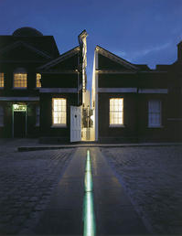
Physical time
Solar time
1 sec = 1 day / 86400
Problem: days are of different lengths (due to tidal friction, etc.)
mean solar second: averaged over many days
Greenwich Mean Time (GMT)
The mean solar time at Royal Observatory in Greenwich, London
Greenwich located at longitude 0, the line that divides east and west
Notes:
? Hong long is 1 second? -> determined by solar day -> clock of 1 second is adjusted to match the length of 1 solar-second.
Solar-day: noon to noon (the sun at the highest point in the sky from a certain point on earth)
GMT time measured at Greenwich, which is located at longitude 0 line (similar to the equator line dividing north and south)

Slide 10
1 Sec
Hong long is 1 second?
determined by solar day
clock of 1 second is adjusted to match the length of 1 solar-second.
Solar-day: noon to noon (the sun at the highest point in the sky from a certain point on earth)
GMT time measured at Greenwich, which is located at longitude 0 line (similar to the equator line dividing north and south)

Slide 11
Coordinated Universal Time (UTC)
International atomic time (TAI)
1 sec ≡ time for Cesium-133 atom to make 9,192,631,770 state transitions.
TAI time is simply the number of Cesium-133 transitions since midnight on Jan 1, 1958.
Accuracy: better than 1 second in six million years
Problem: Atomic clocks do not keep in step with solar time
Coordinated Universal Time (UTC)
Based on the atomic time (TAI) and introduced from 1 Jan 1972
A leap second is occasionally inserted or deleted to keep in step with solar time when the difference btw a solar-day and a TAI-day is over 800ms
Notes:
A TAI-day is about 3 msec shorter than a solar day
A leap second is occasionally inserted if the difference between a solar day and a TAI-day is more than 800msec

Slide 12
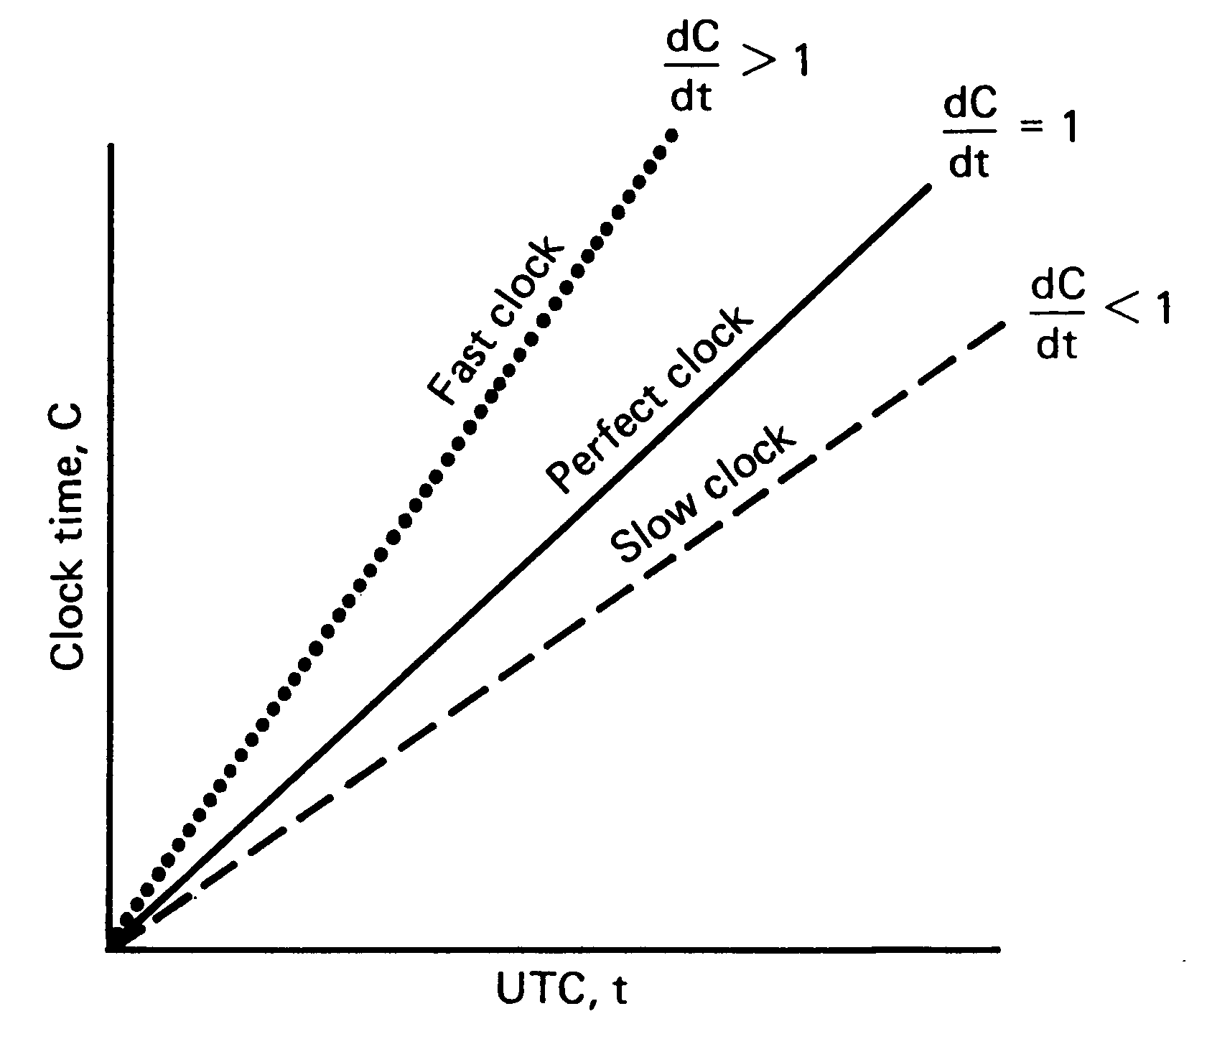
Drift Rate
Is the rate at which the clock ticks.
Different clocks may have different drift rates and hence needs to be synchronized.
One can determine how often they should be synchronized
Not all clock’s tick precisely at the current rate.

Slide 13
Clock Synchronization
It is the process of setting all the cooperating systems of distributed network to the same logical or physical clock.

Slide 14
Logical and Physical Clocks
Clock synchronization is dramatic and it is fitting in process execution. But, Is it possible to synchronize all the clocks in the distributed environment into single clock.
There are different concepts and implementations regarding the clock synchronization by using logical and physical clocks.
logical clocks - to provide consistent event ordering
physical clocks - clocks whose values must not deviate from the real time by more than a certain amount.
14
Synchronization in Distributed Systems
Notes:
14
Assumptions:
Graduate level
Operating Systems
Making Choices about operation systems
Why a micro-century? …just about enough time for one concept

Slide 15
Logical and Physical Clocks
Logical Clocks.
For many applications:
it is sufficient that all machines agree on the same time.
it is not essential that this time also agree with the real time
E.g. make example - it is adequate that all machines agree that it is 10:00 even if it is really 10:02.
Meaning: it is the internal consistency of the clocks that matters, not whether they are particularly close to the real time.
For these algorithms it is conventional to speak of the clocks as logical clocks.
Physical Clocks
when the additional constraint is present that the clocks
must not only be the same,
but also must not deviate from the real time by more than a certain amount,
Then the clocks are called physical clocks.

Slide 16
Problems with Different Clocks
There are several problems that occur as a repercussion of clock rate differences.
Besides the incorrectness of the time itself, there are problems associated with clock skew that take on more complexity in a distributed system in which several computers will need to realize the same global time.
Example: in Unix systems the make command is used to compile new or modified code without the need to recompile unchanged code. The make command uses the clock of the machine it runs on to determine which source files need to be recompiled. If the sources reside on a separate file server and the two machines have unsynchronized clocks, the make program might not produce the correct results
Hence there is a need of Clock Synchronization

Slide 17
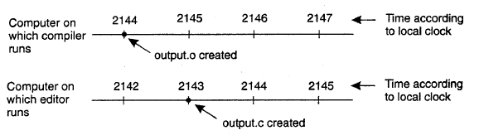
Fig: When each machine has its own clock, an event that occurred after another
event may nevertheless be assigned an earlier time

Slide 18
Event Ordering
Since there is no common memory or clock, it is sometimes impossible to say which of two events occurred first.
The happened-before relation is a partial ordering of events in distributed systems such that
If A and B are events in the same process, and A was executed before B, then A ⇒ B.
If A is the event of sending a message by one process and B is the event of receiving that by another process, then A ⇒ B.
If A ⇒ B and B ⇒ C, then A ⇒ C.
If two events A and B are not related by the ⇒ relation, then they are executed concurrently (no causal relationship)
To obtain a global ordering of all the events, each event can be time stamped satisfying the requirement: for every pair of events A and B, if A ⇒ B then the time stamp of A is less than the time stamp of B. (Note that the converse need not be true.)

Slide 19
Causal Ordering of Messages
If M1 is sent before M2, then every recepient of both messages must get M1 before M2
underlying network will not necessarily give this guarantee.
Consider a replicated database system. Updates to the entries should be received in order!
Basic idea -- buffer a later message

Slide 20
Causal Ordering of Messages
Send(M₁)
P₁
Space
Send(M₂)
P₂
P₃
✴
✶
Time

Slide 21
Global ordering
How do we enforce the global ordering requirement in a distributed environment (without a common clock)?
For each process P_{i} , a logical clock LC_{i} assign a unique value to every event in that process.
If process P_{i} receives a message (event B) with time stamp t and LC_{i}(B) < t, then advance its clock so that LC_{i}(B) = t+1.
Use processor ids to break ties to create a total ordering.

Slide 22
Global State
Due to absence of global clock, states are recorded at different times
For global consistency, state of the communication channel should be the sequence of messages sent before the sender’s state was recorded minus the messages received before the receivers state was recorded.
Local states are defined in context of an application
a send is a part of the local state if it happened before the state was recorded. Ditto for a recv.

Slide 23
Global State
A message causes an inconsistency if it was received, but not sent
A collection of local states forms a global state
This global state is consistent iff there are no pairwise inconsistency between local states.
A message is in transit when it has been sent, but not received.
The global state is transitless iff there are no local state pairs with messages in transit.
Transitless + Consistent ➔ Strongly Consistent State

Slide 24
Clock Synchronization Algorithms
Physical Clock Synchronization
Cristian's algorithm – Centralized System
Berkeley algorithm – Centralized System
Network Time Protocol – Distributed System
Logical Clock Synchronization
Lamport timestamps – Distributed System
Vector clocks – Distributed System

Slide 25
Physical Clock Synchronization
Cristian's algorithm
Berkeley algorithm
Network Time Protocol (NTP)

Slide 26
Cristian's algorithm
Cristian's algorithm relies on the existence of a time server as a physical clock synchronization algorithm.
The time server maintains its clock by using a radio clock or other accurate time source, then all other computers in the system stay synchronized with it.
A time client will maintain its clock by making a procedure call to the time server.
Variations of this algorithm make more precise time calculations by factoring in network radio propagation time.

Slide 27
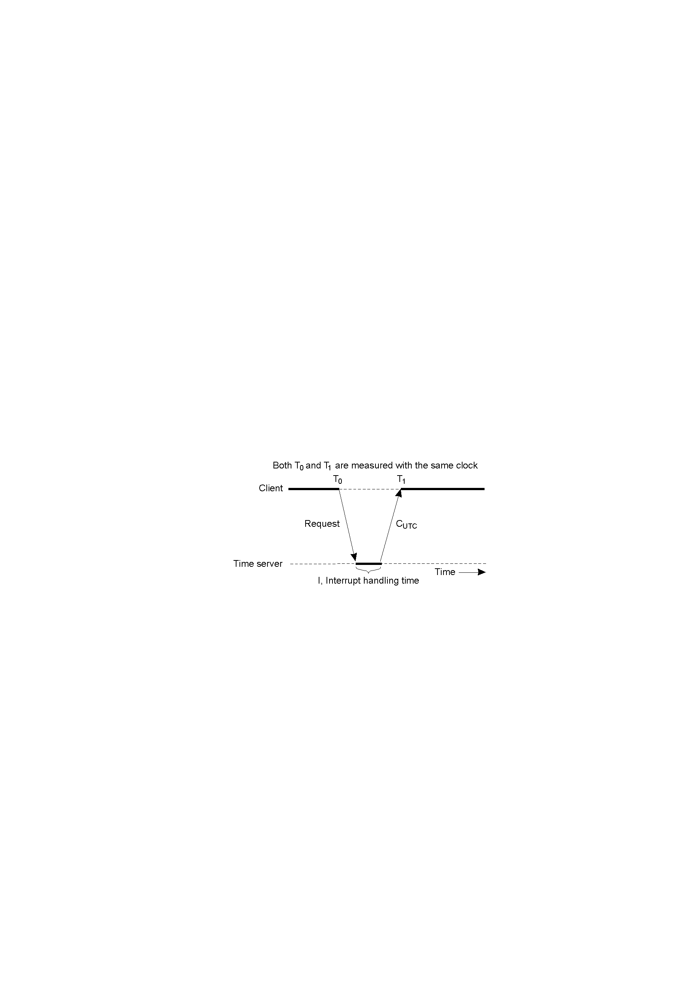
Cristian's algorithm
The time server needs to change its time gradually
The time server, while responding to a client, needs to consider msg delays, subtract
(T1 - T0 – I) which is called Round Trip Time (RTT)
Getting the current time from a time server

Slide 28
Cristian's algorithm
Cristian's Algorithm works between a process P, and a time server S — connected to a source of UTC (Coordinated Universal Time). Then the algorithm goes like this.
P requests the time from S
After receiving the request from P, S prepares a response and appends the time T from its own clock.
P then sets its time to be T + RTT/2

Slide 29
Cristian's algorithm - Accuracy
P needs to record the Round Trip Time (RTT) of the request it made to S so that it can set its clock to T + RTT/2. This method assumes that the RTT is split equally between both request and response, which may not always be the case but is a reasonable assumption on a LAN connection.
Further accuracy can be gained by making multiple requests to S and using the response with the shortest RTT. We can estimate the accuracy of the system as follows.
Let min be the minimum time to transmit a message one-way. The earliest point at which S could have placed the time T, was min after P sent its request. Therefore, the time at S, when the message is received by P, is in the range (T + min) to (T + RTT - min). The width of this range is (RTT - 2*min). This gives an accuracy of (RTT/2 - min).

Slide 30
Cristian’s algorithm: example
Send request at 5:08:15.100 (T₀)
Receive response at 5:08:15.900 (T₁)
Response contains 5:09:25.300 (T_{server})
Round-trip time is T₁ − T₀
5:08:15.900 - 5:08:15.100 = 800 ms
Best guess: timestamp was generated 400 ms ago
Set the local time to T_{server} + round-trip-time/2
5:09:25.300 + 400 = 5:09.25.700
Accuracy: ± round-trip-time/2
T_{server}
server
client
T₀
T₁
Notes:
Use the diagram to explain the error
How to improve the accuracy: 1) the protocol often makes several measurements, and take the one with least round trip
2) ->

Slide 31
Physical Clock Synchronization
Cristian's algorithm
Berkeley algorithm
Network Time Protocol (NTP)

Slide 32
The Berkeley algorithm
Berkeley algorithm is also a physical clock synchronization algorithm based on centralized system.
This algorithm is more suitable for systems where a radio clock is not present.
This system has no way of making sure of the actual time other than by maintaining a global average time as the global time.
A time server will periodically fetch the time from all the time clients, average the results, and then report back to the clients the adjustment that needs be made to their local clocks to achieve the average.
This algorithm highlights the fact that internal clocks may vary not only in the time they contain but also in the clock rate.
Often, any client whose clock differs by a value outside of a given tolerance is disregarded when averaging the results. This prevents the overall system time from being drastically skewed due to one erroneous clock.

Slide 33
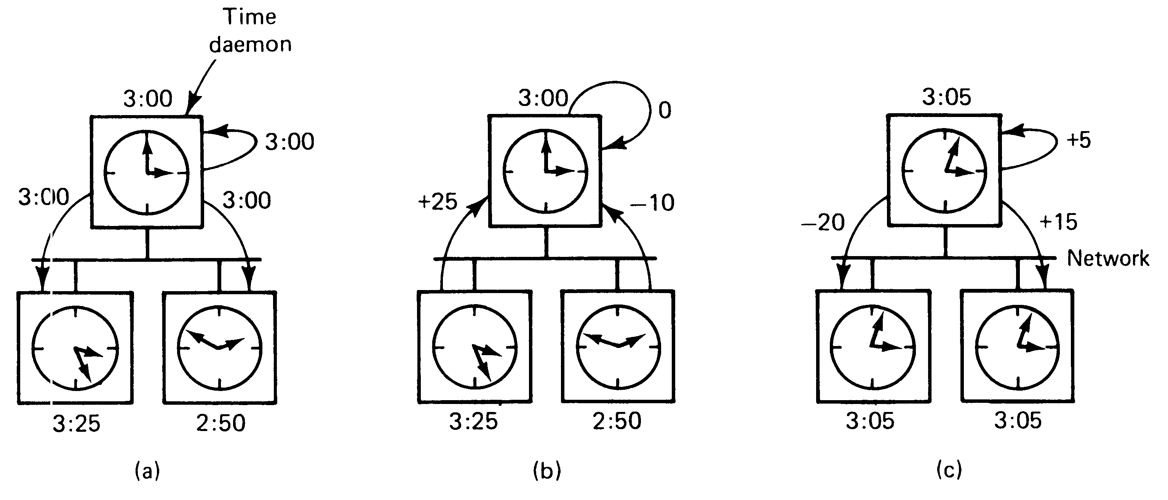
The Berkeley algorithm
Is an averaging algorithm
The time daemon asks all the other machines for their clock values.
The machines answer.
The Time daemon tells everyone how to adjust their clock.

Slide 34
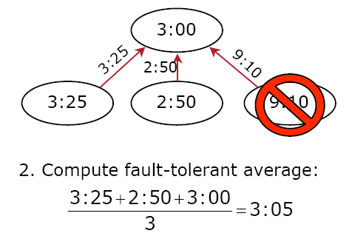
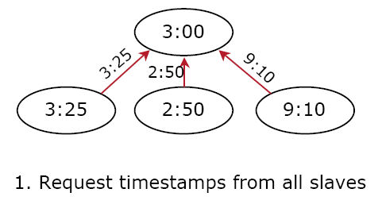
(a)
(b)
+0:05
3:00
-0:20
+0:15
-6:05
3:25
2:50
9:10
(c)
3. Send offset to each client

Slide 35
The Berkeley algorithm
The server process in the Berkeley algorithm, called the master, periodically polls other slave processes to synchronize the physical clock. Generally speaking, the algorithm is:
A master is chosen via an election process such as Chang and Roberts algorithm.
The master polls the slaves who reply with their time in a similar way to Cristian's algorithm.
The master observes the round-trip time (RTT) of the messages and estimates the time of each slave and its own.
The master then averages the clock times, ignoring any values it receives far outside the values of the others.
Instead of sending the updated current time back to the other process, the master then sends out the amount (positive or negative) that each slave must adjust its clock. This avoids further uncertainty due to RTT at the slave processes.

Slide 36
Problem with Berkeley Algorithm
Time not a reliable method of synchronization
Users mess up clocks
(and forget to set their time zones!)
Unpredictable delays in Internet
Relativistic issues
If A and B are far apart physically, and two events T_{A} and T_{B} are very close in time, then which comes first? how do you know?

Slide 37
Physical Clock Synchronization
Cristian's algorithm
Berkeley algorithm
Network Time Protocol (NTP)

Slide 38
Network Time Protocol (NTP)
NTP is the most commonly used Internet time protocol and the one provides best accuracy (RFC 1305, http://tf.nist.gov/service/its.htm ).
Computers often include NTP software in OS. The client software periodically gets updates from one or more servers (average them).
Time servers listen to NTP requests on port 123, and reply a UDP/IP data packet in NTP format, which is a 64-bit timestamp in UTC seconds since Jan 1, 1900 with a resolution of 200 pico-s.
Many NTP client software for PC only gets time from a single server (no averaging). The client is called SNTP (Simple Network Time Protocol, RFC 2030), a simple version of NTP.
Notes:
See http://tf.nist.gov/service/its.htm for NTP
The Network Time Protocol (NTP) is the most commonly used Internet time protocol, and the one that provides the best performance. Large computers and workstations often include NTP software with their operating systems.

Slide 39
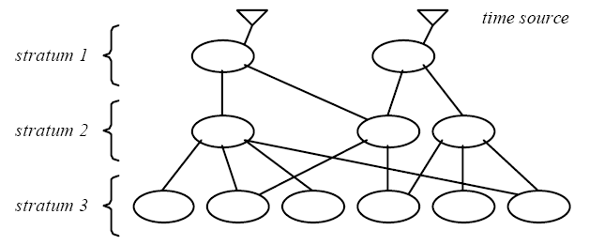
NTP synchronization subnet
1st stratum: machines connected directly to accurate time source
2nd stratum: machines synchronized from 1st stratum machines
…
Notes:
Multipath/multi-server!

Slide 40
NTP goals
Enable clients across Internet to be accurately synchronized to UTC despite message delays
Use statistical techniques to filter data and improve quality of results
Provide reliable service
Survive lengthy losses of connectivity
Redundant paths
Redundant servers
Enable clients to synchronize frequently
Adjustment of clocks by using offset (for symmetric mode)
Provide protection against interference
Authenticate source of data
Notes:
Filter technique: throw away time from bad-servers.
Good quality of results: server’s stratum, min-round trip time, etc.

Slide 41
NTP Synchronization Modes
Multicast (for quick LANs, low accuracy)
server periodically multicasts its time to its clients in the subnet
Remote Procedure Call (medium accuracy)
server responds to client requests with its actual timestamp
like Cristian’s algorithm
Symmetric mode (high accuracy)
used to synchronize between the time servers (peer-peer)
All messages delivered unreliably with UDP
Notes:
RPC mode was discussed before.

Slide 42
NTP (Network Time Protocol)
T₂
T₃
Server
B
Client
A
T₁
T₄
A requests time of B at its own T₁
B receives request at its T₂, records
B responds at its T₃, sending values of T₂ and T₃
A receives response at its T_{4.}

Slide 43
NTP (Network Time Protocol)
T₂
T₃
B
A
T₁
T₄
Question: what is θ = T_{B} – T_{A}?
Assume transit time is approximately the same both ways
Assume that B is the time server that A wants to synchronize to

Slide 44
NTP (Network Time Protocol)
T₂
T₃
B
A
T₁
T₄
A knows (T₄ – T₁) from its own clock
B reports T₃ and T₂ in response to NTP request
A computes total transit time of

Slide 45
NTP (Network Time Protocol)
T₂
T₃
B
A
T₁
T₄
One-way transit time is approximately ½ total, i.e.,
B’s clock at T₄ reads approximately

Slide 46
NTP (Network Time Protocol)
T₂
T₃
B
A
T₁
T₄
B’s clock at T₄ reads approximately
Thus, difference between B and A clocks at T₄ is

Slide 47
Logical Clock Synchronization
Lamport’s timestamps (Algorithm)
Vector clocks (Algorithm)

Slide 48
Lamport’s Algorithm
Lamport invented a simple mechanism by which the happened-before ordering can be captured numerically. A Lamport logical clock is a incrementing software counter maintained in each process.
Algorithm follows:
A process increments its counter before each event in that process;
When a process sends a message, it includes its counter value with the message;
On receiving a message, the receiver process sets its counter to be greater than the maximum of its own value and the received value before it considers the message received.
Conceptually, this logical clock can be thought of as a clock that only has meaning in relation to messages moving between processes. When a process receives a message, it resynchronizes its logical clock with that sender.

Slide 49
Lamport’s Algorithm (2)
The happened-before relation is a partial ordering of events in distributed systems such that
If A and B are events in the same process, and A was executed before B, then A ⇒ B.
If A is the event of sending a message by one process and B is the event of receiving that by another process, then A ⇒ B.
If A ⇒ B and B ⇒ C, then A ⇒ C.
If two events A and B are not related by the ⇒ relation, then they are executed concurrently (no causal relationship)

Slide 50
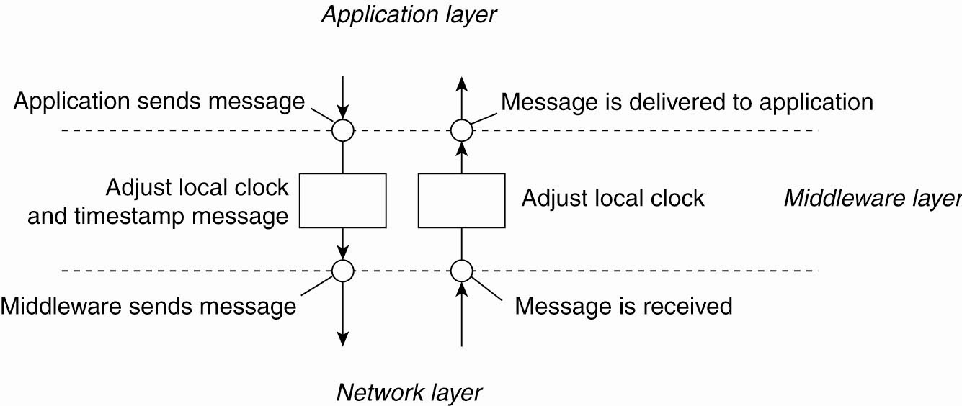
Lamport’s Logical Clocks (3)
Figure 6-10. The positioning of Lamport’s logical clocks in distributed systems.

Slide 51
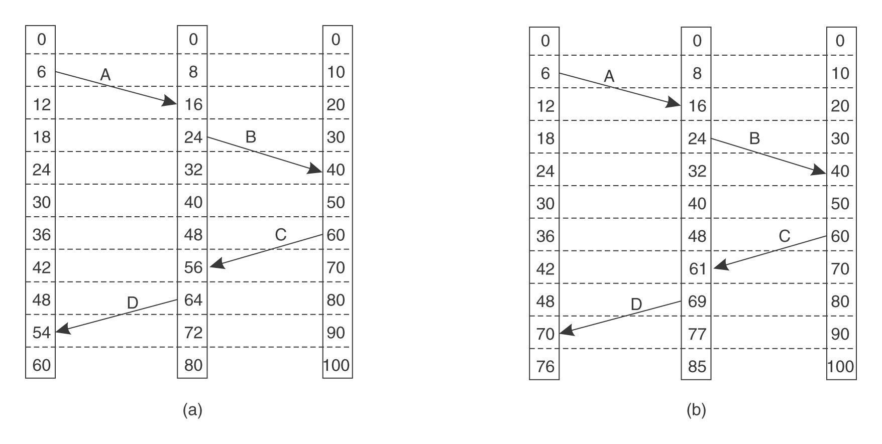
Example: Lamport’s Algorithm
Three processes, each with its own clock. The clocks run at different rates.
Lamport’s Algorithm corrects the clock.
(impossible)
Note: ts(A) < ts(B) does not imply A happened before B.

Slide 52
Lamport’s Considerations
For every two events a and b occurring in the same process, and C(x) being the timestamp for a certain event x, it is necessary that C(a) never equals C(b).
Therefore it is necessary that:
The logical clock be set so that there is minimum of one clock "tick" (increment of the counter) between events and ;
In a multiprocess or multithreaded environment, it might be necessary to attach the process ID (PID) or any other unique ID to the timestamp so that it is possible to differentiate between events and which may occur simultaneously in different processes.

Slide 53
Lamport's logical clock in distributed systems
In a distributed system, it is not possible in practice to synchronize time across entities (typically thought of as processes) within the system; hence, the entities can use the concept of a logical clock based on the events through which they communicate.
If two entities do not exchange any messages, then they probably do not need to share a common clock; events occurring on those entities are termed as concurrent events.
Among the processes on the same local machine we can order the events based on the local clock of the system.
When two entities communicate by message passing, then the send event is said to 'happen before' the receive event, and the logical order can be established among the events.
A distributed system is said to have partial order if we can have a partial order relationship among the events in the system. If 'totality', i.e., causal relationship among all events in the system can be established, then the system is said to have total order.

Slide 54
Vector Clocks
Vector clocks is an algorithm for generating a partial ordering of events in a distributed system and detecting causality violations.
Just as in Lamport timestamps, interprocess messages contain the state of the sending process's logical clock.
A vector clock of a system of N processes is an array/vector of N logical clocks, one clock per process; a local "smallest possible values" copy of the global clock-array is kept in each process

Slide 55
Vector Clocks: Algorithm
Initially all clocks are zero.
Each time a process experiences an internal event, it increments its own logical clock in the vector by one.
Each time a process prepares to send a message, it increments its own logical clock in the vector by one and then sends its entire vector along with the message.
Each time a process receives a message, it increments its own logical clock in the vector by one and updates each element in its vector by taking the maximum of the value in its own vector clock and the value in the vector in the received message (for every element).

Slide 56
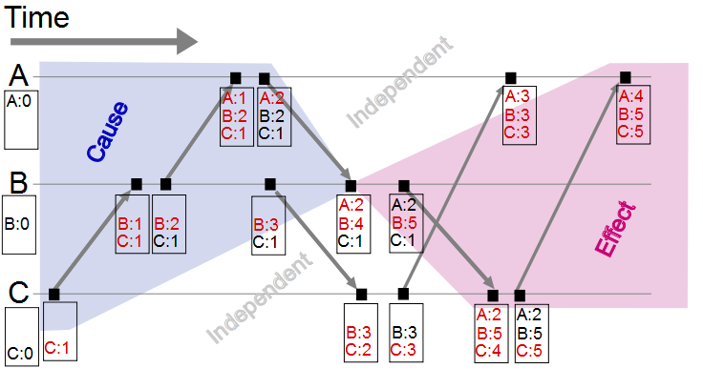
Vector Clock: Example

